Slide 1
Dependents Exemptions
Pub 17 – Chapter 3
Pub 4012 – Tab C
(1040-lines 6c & 6d)
NJ 1040
Notes:
1

Slide 2
Dependent Exemptions Types
Exemption Type | Federal Exemption | NJ Exemption
Dependents: Qualifying child Qualifying relative | Yes | Yes
College Student | Exemption only if college student is a dependent & under 24 | Same exemption as Federal if under 24, plus extra exemption if under 22 (see rules)
NJ generally follows Federal rules for dependent exemptions, but adds an extra exemption for college student < 22

Slide 3
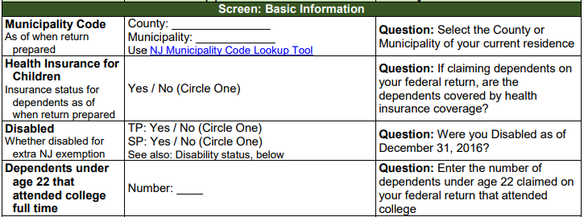
Additional Dependents Input for NJ Return
Most TaxSlayer dependent information is populated based on information from Federal Basic Information section
There is some additional dependent information that you should note in NJ Checklist Basic Information section for later entry in the TaxSlayer State section
Extra exemption for dependents < 22 attending college
NJ health insurance for dependents

Slide 4
Federal/State Differences: Exemptions for College Students
ITEM | FEDERAL | STATE | COUNSELOR ACTION
Depen-dent full-time college student | Parent can claim as dependent if < 24 | Parent can claim exemp-tion if depend- ent on Federal | “Check if this person was a FULL-TIME student” on Dependent page
* Student must attend college full-time for some part of 5 calendar months; parent must pay at least ½ of tuition/ maintenance
Notes:
Requirement that student must spend at least some part of each of 5 calendar months of tax year in school can be a problem during student’s first or last year in college

Slide 5
Federal/State Differences: Exemptions for College Students
(cont’d)
ITEM | FEDERAL | STATE | COUNSELOR ACTION
Depen-dent full-time college student |  | Parent can claim extra ex- emption if < 22 | “Enter the number of dependents under age 22 claimed on your federal return that attended college” in State section \ Basic Information
Notes:
Requirement that student must spend at least some part of each of 5 calendar months of tax year in school can be a problem during student’s first or last year in college

Slide 6
NJ Health Insurance for Dependents
NJ informational question about health insurance coverage for dependents
Does not impact NJ income tax in any way
Used so that NJ can contact people about health insurance through Children’s Health Insurance Program (CHIP) or Family Care
Capture dependent health insurance information in NJ Checklist Basic Information section for later entry in TaxSlayer State section

